Slide 1





DevOps E2E Demo for Kanerika
- By Srinivasa Basu

Slide 2
Agenda
Pre-requisites
Jenkins Server Setup using Terraform
EKS Cluster Setup using Terraform & Jenkins
EKS – Topology
Jenkins Pipeline workflow & configuration
Demo
Q & A

Slide 3
Pre-requisites
AWS Account
GITHUB Account
Base Machine with following installed
AWS CLI
Terraform
GIT
Visual Studio Code

Slide 4
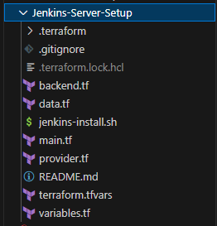
Jenkins Server Setup using Terraform
Provider.tf – Contains the terraform provider details.
Backend.tf – Contains the info for storing tfstate.
Terraform.tfvars – Values for Variables.
Variables.tf – Declare variables information.
Main.tf – Contains main configurations like modules,
resources info, etc.
- In this case, has VPC, SG, EC2 Module Code.
Jenkins-install.sh – Contain shell commands for installing following
- GIT
- Jenkins
- Terraform
- Kubectl

Slide 5
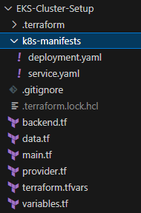
EKS Cluster Setup using Terraform & Jenkins
Provider.tf – Contains the terraform provider details.
Backend.tf – Contains the info for storing tfstate.
Terraform.tfvars – Values for Variables.
Variables.tf – Declare variables information.
Main.tf – Contains main configurations like modules,
resources info, etc.
- In this case, has VPC, EKS Module Code.
K8s-manifests – Contains the k8s YAML code.
- In this case, contains Nginx Deployment
and LB service manifest files.

Slide 6
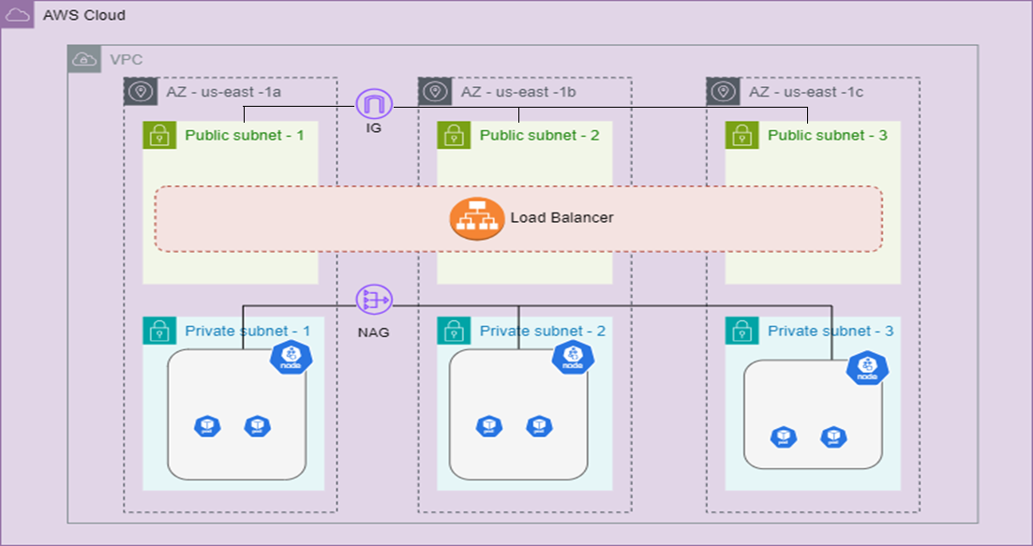
EKS - Topology

Slide 7
Jenkins Pipeline workflow
Push the code to GIT Hub Repository from Local Machine
Jenkins Pipeline detects a code commit and kick start the pipeline
Terraform and K8s Code is checked out to Agent from GITHUB
Initialize Terraform Code
Approve Plan Stage
Abort stage/Pipeline
No
Plan Terraform Code
Validate Terraform Code
Format Terraform Code
Yes
Apply/Destroy the Code for EKS Cluster based on Pipeline Parameter input
Deploy Nginx k8s YAML Files on EKS Cluster
Verify the deployment by accessing the Load Balancer Public IP

Slide 8
Demo!
Demo!
GITHUB Repo: https://github.com/srinibasu/kanerika-devops-demo.git

Slide 9
Q & A !
Q & A!

